Slide 1
Workbook Take Control
Internal Use Only
April 2017

Slide 2
Disclaimer
The content of this workbook has been produced by KPMG Germany/Deal Advisory on the basis of German accounting standards and/or IFRS, as well as considering KPMG Germany’s firm and country requirements, regulations, processes, policies and best practices. Please check your local accounting and other requirements before applying the content.

Slide 3
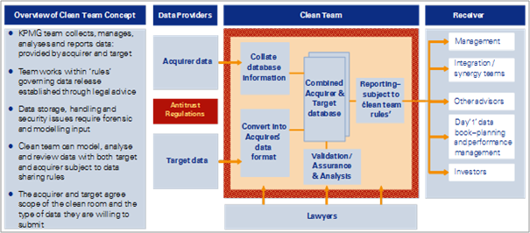
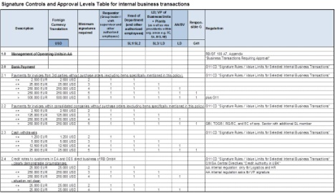
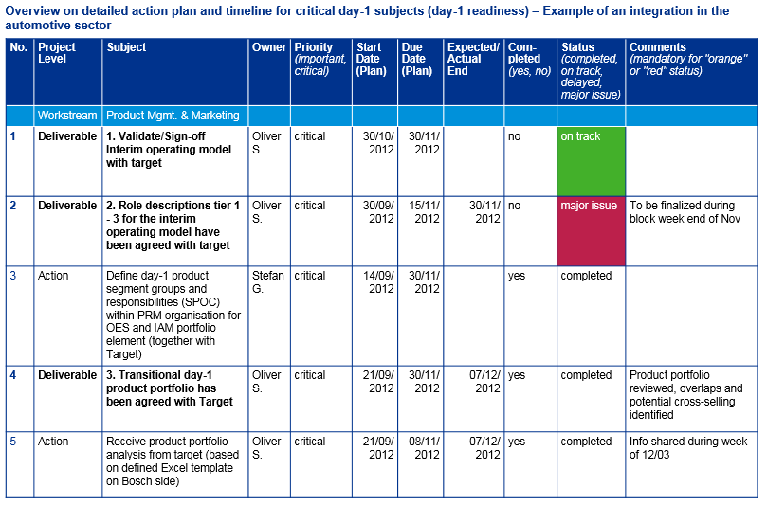
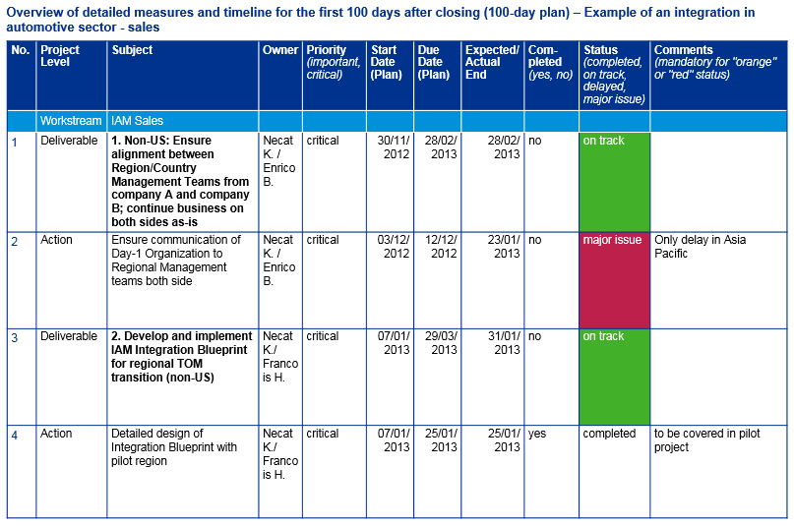
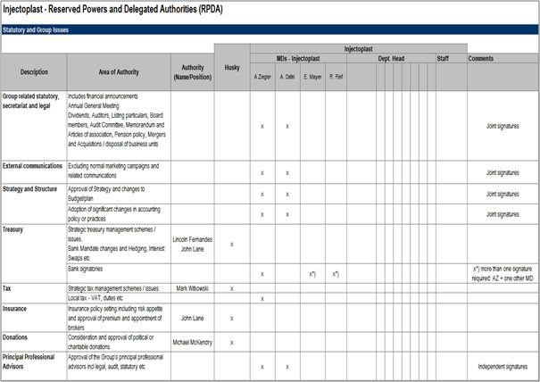
Overview (1/8) – Mission statement
Take Control
Mission Statement:
Assure control over the project, the target company as well as all relevant stakeholders
Customer situation
Definition/Methodology/Tools of the basis analysis
Buy Side/Sell Side/JV
Necessity for taking the entire control over the operations of the target company by closing (buy side) or preparation of the smooth handover of control in case of a sale (sell side) or JV
Definition
Take Control assures the holistic control over all the relevant aspects of the transaction and therefore assures a smooth handling of the transformation
Methodology
Take Control is a collection of documents for the structured overview and provides clear instructions for relevant subjects that are necessary to assure a smooth transformation (pre and post-closing)
For purposes of a rough outline a distinction is made between three relevant areas of control:
Control over the operational business during every phase of the transformation
Control over the transformation project
Control over stakeholder risks
Tools and templates
Degree of standardization
Clean Team
Set Up
RPDA
The approach is standardized
There are tools and templates available for structuring the output
Content is adapted to the specific customer
Day-1-Readiness
100 days-Plan
RPDA = Reserved Powers & Delegated Authorities

Slide 4
Overview (2/8) – Pitfalls
Take Control
No. | Pitfalls/Lessons learned
 | Many risks for the normal operations result from the interdependencies of the individual work streams/functions. During the preparation for day-1 it is therefore necessary to coordinate the individual work streams to identify relevant risks and to determine the necessary measures in good time.
 | The day-1 readiness plan must be prepared some weeks prior to the closing. The implementation of the specific day-1 critical measures must be initiated in good time prior to the closing and are completed by closing or shortly thereafter.
 | At the closing there is frequently great insecurity on the part of employees as well as customers and suppliers. The retention of the most important employees, customers and suppliers by means of specific retention programs and clear communication strategies is therefore a high priority in the day-1 readiness and the 100-day plan.
 | A number of critical measures prior to closing as well as in the implementation of the transaction are not completed on time or properly done due to the fact that necessary resources and capacities, especially of project members that continue to be involved in the operations are underestimated. A realistic estimation of the resources and capacities required is therefore extremely important in delivering the day-1 readiness as well as the 100-day plan. Bottlenecks identified are to be reported to the PMO or escalated early enough.
 | Corporate governance, compliance and RPDA regulations of acquiring global companies that are not adapted, frequently place excessive “organizational demands“ on the target and heavily impact daily operations and consequently the result of the transaction.
1
2
3
4
5

Slide 5
Overview (3/8) – Core issues
Take Control
Core Issue | Specific analysis | Page(s)
How can a clear control over and smooth handling of the operations be assured? | List of the critical measures so as to attain immediate control over the target (buy-side) or JV as of day-1 (day-1 readiness) List of critical subjects that must be addressed by closing or immediately thereafter so as to avoid disruptions of operations (day-1 readiness) Clear organization and definition of operating responsibilities (RPDA - reserved powers and delegated authorities) | 11-15
2. How can a clear control over the entire transformation project be achieved? | Assessment of the complexity of the transformation/ transaction Establishment of a comprehensive and implementable action plan with clear milestones (100-day plan) List, control and monitor of process risks and progress (see also Project Management Support work module) Clear organization and definition of process responsibilities | 16-17
How can control over possible stakeholder risks be achieved? | Definition of the most important stakeholders (customers, employees, suppliers, etc.) (see also People, Culture & Communication Workbook) Analysis of possible risks per stakeholder group and definitions of possible measure to address them Stipulation of information guidelines for individual stakeholder groups and analysis of sensitive data, especially pre-closing (clean team) | 18-19

Slide 6
Overview (4/8) – Placement in the overall transaction process
Take Control
4 weeks
10-12 weeks^{(a)}
100 days
100 days +
Pre-Signing
Pre-Closing
Post-Closing first 100-Days
Beyond the ...deal
Beyond the ...deal
Signing
Completion/Day 1
100 Days
Objective:
Confirm and document the strategic intent, value drivers, initial view on the target operating model and high level target structure Documentation and approval:
Deal rationale
Depth of integration
Risks and measures
Organization blueprint and high level TOM
High level synergy assessment
Stakeholder mapping and approved communication elements
Timeline for the integration
Objective:
Guarantee “day-1 readiness“ for control over the process, the integration goals and the daily business as of closing; target operating model and synergy case
Documentation and approval:
Day 1 communication & event
“Take control“ as of day of closing
As-is, interim and target operating model
Change management, culture and retention plan
Synergy case
Objective:
Establish newly created structures while minimizing the disruption to the normal business, deliver Quick Wins and integrate fast and effectively Implementation:
Realized quick wins
Adjusted financial business plan (bottom-up)
Robust benefit & synergy tracking including corresponding project structure
Initial validation/Detailing TOM
Ongoing communication & merger of cultures
Objective:
Successfully complete Integration and identify further areas for operational improvement
Realized synergies/value from the deal
Completed required integration projects
Identification of value levers and implementation of on-going optimization measures
Captured learnings from integration for further deals within the internal team
Perform “second wave of integration“ if necessary
Vision and
approach
Value
Control
People and culture
PMO
Objective
Establish and maintain appropriate processes and integration governance (adequately resourced) to ensure that the integration program stays on track and deal objectives are delivered
Note: (a) The time between signing and closing may be between 0 (same day) and several months

Slide 7
Overview (5/8) – Approach Day-1-Readiness
Take Control
Details on Methodology/Approach
1
2
3
Understanding initial basis
Develop day-1 readiness plan
Approve and comply
Further integration/Separation/JV approach
Understanding initial basis
Develop day-1 readiness plan
(pre-closing)
Approve and comply
(pre-closing)
1
2
3
Approach:
Analysis of the integration/separation/JV blueprint
Analysis of as-is, interim and target operating models (if available)
Analysis of the integration/separation/JV hot spots and risks per workstream/function as well as interdependencies with other workstreams/functions
Attain understanding for typical day-1-critical issues with the aid of the KPMG Day-1 checklists
Approach:
Processing of the day-1-critical issues per workstream/function in a day-1 readiness-plan including clear responsibilities, prioritization and deadline
Development of a red flag report for critical issues or for lacking resources/capacities with regard to the timely implementation of the day-1 measures and actions
Escalation of foreseeable time or resource-critical subjects to PMO
Summary of the individual day-1 readiness plans and review for additional interdependencies
Approach:
Approval of the day-1 plans by the workstream sponsors, the PMO and, if needed, the top management
Tracking of the individual measures with regard to the timely and proper completion by workstream leads and PMO
Development of a red flag report for delayed or day-1 critical issues
Development of a red flag report for lack of resources/capacity with regard to the timely implementation of the day-1 measures and actions
Escalation of time or resource-critical subjects to PMO
Process steps

Slide 8
Overview (6/8) – Approach Reserved Powers and Delegated Authorities (RPDA)
Take Control
Details on Methodology/Approach
1
2
3
Understanding initial basis
Develop RPDA
Coordination & approval
Further integration/Separation/JV approach
Understanding initial basis
Develop RPDA
(pre-closing)
Coordination & approval
(pre-closing)
1
2
3
Approach:
Analysis of the current signatory and representative powers, powers of attorney, decision-making authority, release processes and value limits along the relevant departments of the value chain and support functions with the buyer/target or JV partners
Identification of the largest deviations for the prioritization of the RPDA development
Approach:
Adjustment of the generic RPDA template for the customer-specific situation employing the input from the TOM and organizational development for the stipulation of the decision-making levels and value limits
Conduct workshops with the relevant work streams/functions and/or management for the adjustment of the RPDAs
Identification of necessary adjustments (e.g. system adjustments for approval processes) for the operating implementation of the adjusted RPDAs
Approach:
Coordination and approval of the adjusted RPDAs by the top management
Preparation of the communication of the adjusted RPDAs to the relevant stakeholders (pre- or post-closing)
Process steps
RPDA = Reserved Powers & Delegated Authorities ; TOM = Target Operating Model

Slide 9
Overview (7/8) – Approach 100 days-Plan
Take Control
Details on Methodology/Approach
1
2
3
4
Understanding initial basis
Develop 100-day plan
Detail 100-day plan
Approve and comply
Further integration/Separation/JV approach
Understanding initial basis
Develop 100-day plan
(pre-closing)
Detail 100-day plan (post-closing)
Approve and comply
(pre- and post-closing)
1
2
3
4
Approach:
Analysis of the integration/ separation/JV blueprints
Analysis of synergy plans
Analysis of as-is, interim and target operating models (if available)
Analysis of the integration/ separation/JV hot spots and risks per workstream/function and the interdependencies with other workstreams/functions
Analysis of high-level implementation plan and defined milestones
Approach:
Development of the necessary measures for the implementation of the transaction per workstream/ function in a 100-day plan including clear responsibilities, priorities and timeline
Development of red flag reports for issues with critical content or a lack of resources/capacity for the measures and actions
Summary of the individual 100-day plans and review for further interdependencies by PMO
Approach:
Detailing of the 100-day measures and, if necessary, adjustment of the timelines after improved access to information from target/buyer/ JV partner
Development of red flag reports for a lack of resources/capacity
Escalation of foreseeable time or resource-critical issues to PMO
Approach:
Approval of the 100-day plans by the workstream sponsors, the PMO and, if necessary, the top management
Tracking of the individual measures with regard to deadlines and proper performance by Workstream Leads and PMO
Development of red flag reports for time or resource-critical issues
Escalation of time or resource-critical issues to PMO
Process steps

Slide 10
Overview (8/8) – Clean team approach
Take Control
Details on Methodology/Approach
1
2
3
4
Process request
Establish clean team
Perform analysis
Dissolve clean team
Further integration/Separation/JV approach
Process request
Establish clean team
(pre-signing & pre-closing)
Perform analysis (pre-signing & pre-closing)
Dissolve clean team
(pre- or post-closing)
1
2
3
4
Approach:
Analyze analysis requirements (content, legal restrictions, timeline)
Define data requirements
Determine approach for data collection
Nominate clean team members (in case of highly sensitive data/data relevant for competition law only for external members)
Stipulate process for the destruction of sensitive/confidential information (in case deal is annulled)
Obtain release by PMO and legal department
Approach:
Establish the clean team environment (virtual or on actual site)
Organize access to clean room
Establish governance
Set up data access rights and communication systems
Signing of NDAs by members of clean team
Approach:
Specify analysis requirements/output formats
Collect, archive and approve relevant data with legal supervision
Perform the analysis and summary of the results
Continuous documentation of the incoming and outgoing data
Approach:
Presentation of the results of the analysis to management (pre-closing after release by legal; for confidential or competition-relevant only post-closing)
Dissolve clean team after defined process
In case closing is annulled, destroy sensitive data in accordance with stipulated process
Process steps
NDA = Non Disclosure Agreement ; PMO = Project Management Office

Slide 11
1. How can a clear control over and smooth handling of the operations be assured? (1/5)
Take Control
Core Statements:
Presentation of day-1 critical subjects along the relevant areas of the value chain
Day-1 critical subjects based on outside-in analysis and lessons learned
Overview of the project hot spots
Overview of critical day-1 subjects (day-1 readiness) – Example of an integration in the automotive sector
Operations | Personnel | Sales & communication
Assure business-critical processes and systems Coordination and approval of the engineering teams on-site with overlapping customers Harmonisations of quality claim and process without “laming” the organisation with new standards Quick decisions required for (“Go/No-go“) for current projects Location concept Altered management authority within the functions ”Engineering culture", highly sensitive with regard to change of the working environment (e.g. uniform CAx-systems) | Integration personnel management and administration Recruiting Two employer brands in one company? External presence? Decision on future recruiting system Safeguard Candidate pipeline Training Consolidation of training activities "Best of both worlds" with regard to competence management Retention No migration of major knowledge bearers & talents as a result of uncertainty Culture and communication Different corporate cultures, frictions in the cooperation Employee communication | Management of overlapping customer relations Avoidance of transition losses due to excessive dominance with overlapping customers Development of a joint "Go-to-market” approach, clarification of brands/image (Marketing) External communication planning to customers and the market and compiling of content of communications

Slide 12
1. How can a clear control over and smooth handling of the operations be assured? (2/5)
Take Control
Core Statements:
Presentation of day-1 critical subjects along the relevant areas of the value chain
Day-1 critical subjects based on outside-in analysis and lessons learned
Overview of the project hot spots
Overview of critical day-1 subjects (day-1 readiness) – Example of an integration in the automotive sector (cont’d)
Organisation, tax, legal | IT | Finance
Identification of the optimal corporate structure and legal form Consideration of co-determination issues Clarification of general tax conditions (national and international) Review/Harmonisation of security/ confidentiality regulations Determination of organisational structure (interim, target) Headquarter location Harmonisation of contract mgmt., GTC, etc. Harmonisation of patent applications Contract conversions (customers, suppliers) | Identification of critical IT-applications, high dependency of business on a functioning IT (e.g. CAx licenses) Analysis and assessment of IT landscape and planning of the two companies (e.g. standard-like SAP-solution at ENZO) Determination of the IT integration strategy (”pragmatic, cost-optimised IT integration"), e.g. Synergies (license acquisition, …) Check usability of jEDWIN IT administration tool for RACE IT technical connection of RACE locations via ENZO VPN-structure Very tight IT cost controls | Determination of guidelines for future reporting structure amongst others (Balance sheet) handling of the carved-out units Harmonise business materials (pre-printed material, forms) Clarification and assurance of ”combined financial statement" Integration of financial administration (accounting, etc.) Stipulation of the cost-centre structure Assure liquidity Harmonise and establish governance systems that are capital market capable Harmonise insurance

Slide 13
1. How can a clear control over and smooth handling of the operations be assured? (3/5)
Take Control
Core Statements:
Breakdown of project issues into deliverables and actions, prioritized according to critical and important issues
Stipulation of responsibilities per measure
Stipulation of starting and due date as well as expected end in case of delays
Status of the measures will be shown as completed, on track, delayed or major issue
Comment field for additional information
Overview on detailed action plan and timeline for critical day-1 subjects (day-1 readiness) – Example of an integration in the automotive sector
No. | Project Level | Subject | Owner | Priority (important, critical) | Start Date (Plan) | Due Date (Plan) | Expected/ Actual End | Com-pleted (yes, no) | Status (completed, on track, delayed, major issue) | Comments (mandatory for "orange" or "red" status)
 | Workstream | Product Mgmt. & Marketing
1 | Deliverable | 1. Validate/Sign-off Interim operating model with target | Oliver S. | critical | 30/10/ 2012 | 30/11/ 2012 |  | no | on track
2 | Deliverable | 2. Role descriptions tier 1 - 3 for the interim operating model have been agreed with target | Oliver S. | critical | 30/09/ 2012 | 15/11/ 2012 | 30/11/ 2012 | no | major issue | To be finalized during block week end of Nov
3 | Action | Define day-1 product segment groups and responsibilities (SPOC) within PRM organisation for OES and IAM portfolio element (together with Target) | Stefan G. | critical | 14/09/ 2012 | 30/11/ 2012 |  | yes | completed
4 | Deliverable | 3. Transitional day-1 product portfolio has been agreed with Target | Oliver S. | critical | 21/09/ 2012 | 30/11/ 2012 | 07/12/ 2012 | yes | completed | Product portfolio reviewed, overlaps and potential cross-selling identified
5 | Action | Receive product portfolio analysis from target (based on defined Excel template on Bosch side) | Oliver S. | critical | 21/09/ 2012 | 08/11/ 2012 | 07/12/ 2012 | yes | completed | Info shared during week of 12/03

Slide 14
1. How can a clear control over and smooth handling of the operations be assured? (4/5)
Take Control
Core Statements:
Breakdown of project issues into deliverables and actions, prioritized according to critical and important issues
Stipulation of responsibilities per measure
Stipulation of starting and due date as well as expected end in case of delays
Status of the measures will be shown as completed, on track, delayed or major issue
Comment field for additional information
Overview on detailed action plan and timeline for critical day-1 subjects (day-1 readiness) – Example of an integration in the automotive sector (cont’d)
No. | Project Level | Subject | Owner | Priority (important, critical) | Start Date (Plan) | Due Date (Plan) | Expected/ Actual End | Com-pleted (yes, no) | Status (completed, on track, delayed, major issue) | Comments (mandatory for "orange" or "red" status)
 | Workstream | Product Mgmt. & Marketing
6 | Action | Analyze together with target “Combined product portfolio analysis" (based on pre-defined Excel template) and prepare & distribute documents on overlapping products (all markets, all customers) | Oliver S. | critical | 18/09/ 2012 | 15/11/ 2012 | 06/12/ 2012 | yes | completed | Supported by product managers Expected delay due to currently limited contact and uncertainty regarding capacity of product managers on both sides to support analysis Communication regarding timeline has been sent to product managers on Bosch side
7 | Action | Draft transitional day-1 product portfolio together with target based on product portfolio analysis; Align with required functions, e.g. Sales, R&D | Oliver S. | important | 21/09/ 2012 | 15/11/ 2012 | 07/12/ 2012 | no | delayed | Expected delay due to currently limited contact with Target

Slide 15
1. How can a clear control over and smooth handling of the operations be assured? (5/5)
Take Control
Core Statements:
Overview of the approval processes for financial transactions up to certain limits and corresponding approval steps
Overview RPDA –Example Finance (excerpt)
excerpt

Slide 16
2. How can a clear control over the entire transformation project be achieved? (1/2)
Take Control
Core Statements:
Breakdown of project issues into deliverables and actions, prioritized according to critical and important issues
Stipulation of responsibilities per measure
Stipulation of starting and due date as well as expected end in case of delays
Status of the measures will be shown as completed, on track, delayed or major issue
Comment field for additional information
Overview of detailed measures and timeline for the first 100 days after closing (100-day plan) – Example of an integration in automotive sector - sales
No. | Project Level | Subject | Owner | Priority (important, critical) | Start Date (Plan) | Due Date (Plan) | Expected/ Actual End | Com-pleted (yes, no) | Status (completed, on track, delayed, major issue) | Comments (mandatory for "orange" or "red" status)
 | Workstream | IAM Sales
1 | Deliverable | 1. Non-US: Ensure alignment between Region/Country Management Teams from company A and company B; continue business on both sides as-is | Necat K. / Enrico B. | critical | 30/11/ 2012 | 28/02/ 2013 | 28/02/ 2013 | no | on track
2 | Action | Ensure communication of Day-1 Organization to Regional Management teams both side | Necat K. / Enrico B. | critical | 03/12/ 2012 | 12/12/ 2012 | 23/01/ 2013 | no | major issue | Only delay in Asia Pacific
3 | Deliverable | 2. Develop and implement IAM Integration Blueprint for regional TOM transition (non-US) | Necat K./ Francois H. | critical | 07/01/ 2013 | 29/03/ 2013 | 31/01/ 2013 | no | on track
4 | Action | Detailed design of Integration Blueprint with pilot region | Necat K./ Francois H. | critical | 07/01/ 2013 | 25/01/ 2013 | 25/01/ 2013 | yes | completed | to be covered in pilot project

Slide 17
2. How can a clear control over the entire transformation project be achieved? (2/2)
Take Control
Core Statements:
Breakdown of project issues into deliverables and actions, prioritized according to critical and important issues
Stipulation of responsibilities per measure
Stipulation of starting and due date as well as expected end in case of delays
Status of the measures will be shown as completed, on track, delayed or major issue
Comment field for additional information
Overview of detailed measures and timeline for the first 100 days after closing (100-day plan) – Example of an integration in automotive sector – sales (cont’d)
No. | Project Level | Subject | Owner | Priority (important, critical) | Start Date (Plan) | Due Date (Plan) | Expected/ Actual End | Com-pleted (yes, no) | Status (completed, on track, delayed, major issue) | Comments (mandatory for "orange" or "red" status)
 | Workstream | IAM Sales
5 | Action | Final agreement on detailed integration blueprint for all regions with Top-Management | Necat K./ Francois H. | critical | 21/01/ 2013 | 29/01/ 2013 | 24/01/ 2013 | no | on track
6 | Deliverable | RD briefing and kick-off implementation preparation | Necat K./ Francois H. | important | 04/02/ 2013 | 04/02/ 2013 | 07/01/ 2013 | no | delayed | For pilot region
7 | Action | Define detailed implementation plan Region by Region incl. migration strategy to Tier 4-x | Necat K./ Francois H. | critical | 04/02/ 2013 | 01/03/ 2013 | 31/01/ 2013 | no | on track | For pilot SEW region
8 | Action | RD to identify and nominate regional sales manager designated | Necat K./ Francois H. | important | 18/02/ 2013 | 15/03/ 2013 | 07/01/ 2013 | no | on track | For pilot region, mainly WTE sales manager

Slide 18
3. How can control over possible stakeholder risks be achieved? (1/2)
Take Control
Core Statements:
Classification of the most important stakeholders with regard to their influence on and attitude toward the integration project
Classification of the degree of influence from low to high
Classification of the attitude from blocking to neutral to committed
Presentation of a stakeholder mapping of an integration project in automotive sector
STAKEHOLDER MAP (EXAMPLE)
EXAMPLE

Slide 19
3. How can control over possible stakeholder risks be achieved? (2/2)
Take Control
Core Statements:
Classification of the clean team environment in 3 phases; with 2 active clean team process phases
Clean team works separated from the integration teams of companies A and B during the first two phases
Overview of the clean team environment and process in the framework of an integration project
Phase 1
Phase 2
Phase 3
Defining of Environment
JumpStart Planning
st
1
100
-
Days Execution
Launch
Company A
Company A
Define
Combined
Executives
Functional
Integration
&
Integration Data Collection, Develop
Integration
Current
Milestone
Teams
Subject Matter
Timeline & Key Milestone
Teams
Functions &
Implement
Experts
End State
Share
New
CLEAN ROOM – Legal Protocols – Fire Wall
C
Clean
Financial
L
Room Data
Reporting
Draft
O
S
KPMG
Validate &
Clean
Develop
Approved
Develop
Integrated
E
Finalize
Integration Team
Quantify New
Room
Integration
Functional
Functional
Work Plan
Functional
Execution of
–
Data Collection
Synergies
Report
Assumptions
Joint Team
End States
End States
the
Meetings
Day One
Integration
Plan
Finalize
Work Plan
Functional
Clean Room Data Collection (Secured Websites)
Work Plans
Integration Plans & Communications
Issues & Risk Management Processes & Manage Critical Milestones
CLEAN ROOM – Legal Protocols – Fire Wall
Company B
Company B
Define
Functional
Synergy Accountability
Executives &
Integration Data Collection, Develop
Integration
Current
Milestone
Tracking & Capture
Subject Matter
Timeline & Key Milestone
Teams
Functions &
„Score Card"
Experts
End State

Slide 20
© 2017 KPMG International Cooperative (“KPMG International”). KPMG International provides no client services and is a Swiss entity with which the independent member firms of the KPMG network are affiliated.

